Slide 1
SKB Serial number
By. ALT SH, SON

Slide 2
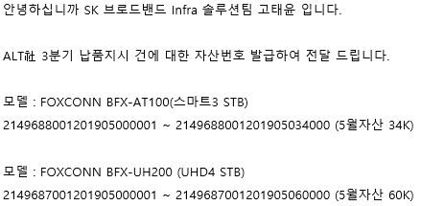
1. SKB Requirement
SKB Serial number(= SKB Asset number) requirement.
This requirement is mandatory for SKB
  SKB first registered SKB serial number in SKB DB and notify this number.
  Manufacture should be followed the SKB Serial number when the production
  Only the registered SKB number can be put on the SKB where house.
  Ex.) PO 1K -> e, Asset number per STB
  : sequential number : 000001~001000

Slide 3
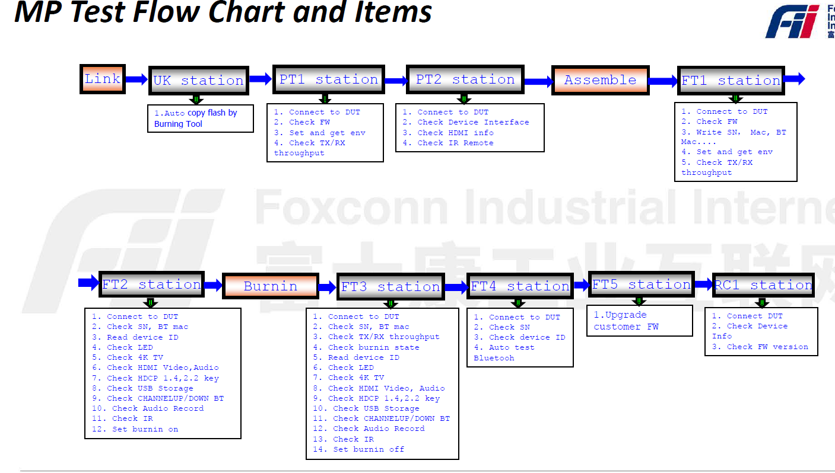
2. Manufacturing process flow.
AS IS : FXN Factory Manufacturing process flow
  All serial numbers (FXN, SKB, MAC) are matched.
PCBA process :
use PCBA FXN S/N
S/N | MAC | SKB S/N | PCBA S/N
1231231231 | aa:bb:cc:dd:ee | 1231231231231 | Abcdefg
1231231232 | aa:bb:cc:dd:ed | 1231231231232 | abcedfh
Print SET label
With SKB S/N
Attached Label
With SKB S/N
Already assigned and matched S/N and Mac and SKB S/N each Lot
(example)

Slide 4
3. Problems
ALT will notice the each lot serial number range
  example
FXN should be match each lot unit serial number range.
If not matched serial number, will be rejected form SKB.
Currently FNX VN factory MES system is not ready this SKB requirement.
P/O No. | Model | Q'ty(LOT) | Date* | S/N (The start no.) | S/N (The last no.) | S/N Issue date (To FXN)
ALT190320‐STB | BFX-AT100 | 1,000 | Jun 19th, 2019 | 2149688001201904000001 | 2149688001201904001000 | Apr 25th, 2019
 | BFX-AT100 | 9,000 | Jul 26th 2019 | 2149688001201904001001 | 2149688001201904010000 | Apr 25th, 2019
 | BFX-AT100 | 10,000 | Aug 26th 2019 | 2149688001201904010001 | 2149688001201904020000 | Apr 25th, 2019
P/O Total |  | 20,000

Slide 5
4. Suggest Manufacturing process flow
All production proceed based on FXN number
FXN SET serial number should be no effect Google CTS requirements.
Add the customer material at BOM “SKB S/N barcode”. And include this item at gift packing station.
When gift packing station, upload SKB S/N by barcode scanner and matched each packed FXN S/N
Find a way to be meet the SKB requirement on FXN MES System

Slide 6
5. Reference
. Other SKB Manufacture manufacturing flow
Other process
SMT
Label station
Print the SKB S/N label
This number will be noticed by ALT
DIP
UK
S/N | MAC | SKB S/N | PCBA S/N
1231231231 | aa:bb:cc:dd:ee |  | Abcdefg
1231231232 | aa:bb:cc:dd:ed |  | abcedfh
PT
Print the SKB Label
Assembly
Production - OEM S/N with temporary label
- MES db example
FT
Burning
SKB Temp Label
Customer material, (temporary use)

Slide 7
5. Reference
. Other SKB Manufacture manufacturing flow
Print the SET and Gift label
SKB S/N
Upload SKB S/N. paring FXN S/N with SKB S/N
Customer material,
(temporary use)
Gift packing
SKB Temp Label
SCAN OEM S/N
SCAN SKB S/N
SKB temp label scrap. no more use in production line.
Production - OEM S/N
Print SET Label
Paring OEM and SKB S/N. Print DEVICE LABEL
S/N | MAC | SKB S/N | PCBA S/N
1231231231 | aa:bb:cc:dd:ee | ~~~20190001 | Abcdefg
1231231232 | aa:bb:cc:dd:ed | ~~~20190002 | abcedfh
Attached SET Label
Print Gift Label
Gift packing with attached label
- MES db example
Carton packing
OBA Test
Pallet packing

Slide 8
5. Reference
. Other SKB Manufacture manufacturing flow
In case of NG OBA Test
Upload SKB S/N. paring OEM S/N with SKB S/N
Gift packing
SKB Temp Label
Print the SET and Gift label
Production - OEM S/N
Carton packing
OBA Test
Test NG
SKB Temp Label Print
STB
SKB S/N
Use unpaired SKB S/N
Attached the OEM S/N label
Remove SET Label.
And unpairing OEM S/N with SKB S/N from db
S/N | MAC | SKB S/N | PCBA S/N
1231231231 | aa:bb:cc:dd:ee |  | Abcdefg
1231231232 | aa:bb:cc:dd:ed | ~~~20190002 | abcedfh
Repair
- MES db example

Slide 9
EOD

